Slide 1




Ways to Keep Yourself Occupied
(During COVID19)

Slide 2

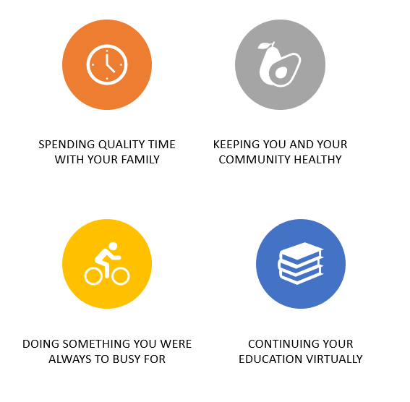

POSITIVE THINGS IN YOUR LIFE
Notes:
There is a lot going on in the world right now. We are practicing Social Distancing so this is the time to think about the positive.

Slide 3

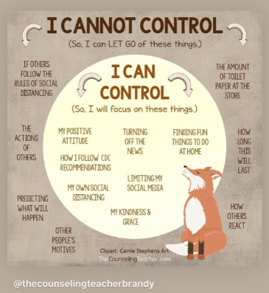

Notes:
Some things we can’t control , like a virus or rules so we have to focus on things we can control. Like activities and keeping busy….

Slide 4


INDOOR ACTIVITIES
Read a book/audiobook
Draw or paint – Lunch Doodles (weekdays at 1:00)
Work on writing a poem, song lyrics or journal
Exercise/Yoga – live workouts
Clean or organize your room, go through your clothes
Make your family dinner / Bake
Play old board games / Cards / puzzles
Listen to a podcast
Create cards and artwork to nursing homes and hospital staff/first responders
Sharing artwork on Face Book for nursing homes
Creating activities for younger siblings
Service activities - helping elderly neighbors
Listen to music
Dance / learn a dance on TikTok
Write emails or letters and mail to friends, call or Face Time/Skype/Zoom
Watch a movie / Netflix party
Make picture books / collages
Learn a new language
Career exploration
Learn life skills (how to balance a checkbook, do laundry, change oil)
Find tutorials on YouTube to try a new skill
Start a new hobby:
  Learn a musical instrument
  Sewing
Notes:
During your down time we have put together some activities to keep you busy
We will push out a page with this list and links for you
Option – have students grab a pointer and put it next to an activity that you would want to do this weekend

Slide 5


VIRTUAL FUN
Virtual Museum Tours
Virtual College Tours
Virtual National Park Tours
Virtual Broadway Plays
Nightly Met Opera Streams
Zoo Live Streaming
Virtual Field Trips
https://whereimaginationgrows.com/virtual-field-trips-for-kids/
Notes:
https://whereimaginationgrows.com/virtual-field-trips-for-kids/

Slide 6



OUTSIDE ACTIVITIES
Geocaching
Nature hike
Go for a walk, run or bike
Messy science experiment
Sidewalk chalk
Wash a car or a bike
Go on a scavenger hunt
Fly a kite
Have a picnic lunch or dinner
Garden
Rollerblade or skateboard
Practice a sport
Bubbles
Bocce
Play foursquare
Build a bird house
Camping
Walk your dog
Notes:
Make sure to get parent permission
Try to get outside to get fresh air everyday

Slide 7
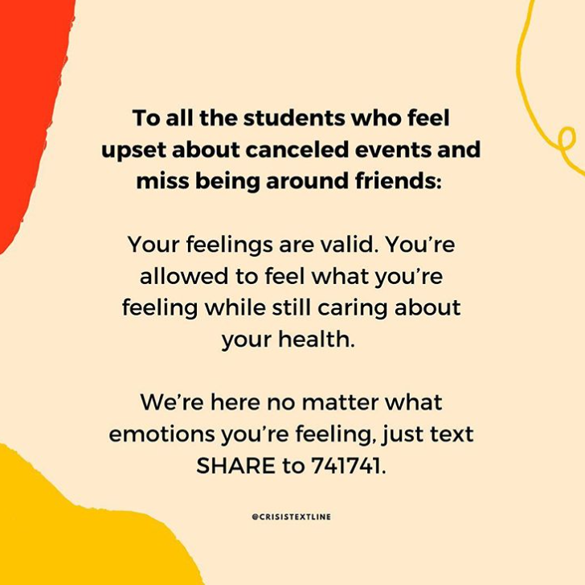



RESOURCES
Notes:
Crisis text Line , suicide prevention & 211 (for essentials like food, clothing, utilities)
We provided resources for PA
**Push out list of activities with links

